Slide 1

The Number of
Non-overlapping Unfoldings in Convex Polyhedra
CCCG2025
Takumi Shiota† Yudai Enomoto‡ Masashi Gorobe ‡
Takashi Horiyama ‡ Tonan Kamata§ Toshiki Saitoh¶ Ryuhei Uehara§
† University of Hyogo ‡ Hokkaido University
§Japan Advanced Institute of Science and Technology
¶ Kyushu Institute of Technology
August 14, 2025 @York University, Toronto

Slide 2
Unfoldings
Definition 1 [E. D. Demaine and J. O’Rourke, 2007]
A general unfolding of a polyhedron is a flat polygon obtained by cutting along its edges and faces, then unfolding its faces into a plane. When the cuts are restricted to its edges, this is called an edge unfolding.
Cutting along the thick line on the left cube of each pair …
(a) General unfolding
(b) Edge unfolding

Slide 3
#(Edge unfoldings)
A polyhedron can get different edge unfoldings depending on which edges are cut.
[Ex.] A cube has 11 different edge unfoldings.

Slide 4
Overlapping / Non-overlapping
When the polyhedron is edge unfolded along the thick lines…
Overlapping unfolding

Slide 5
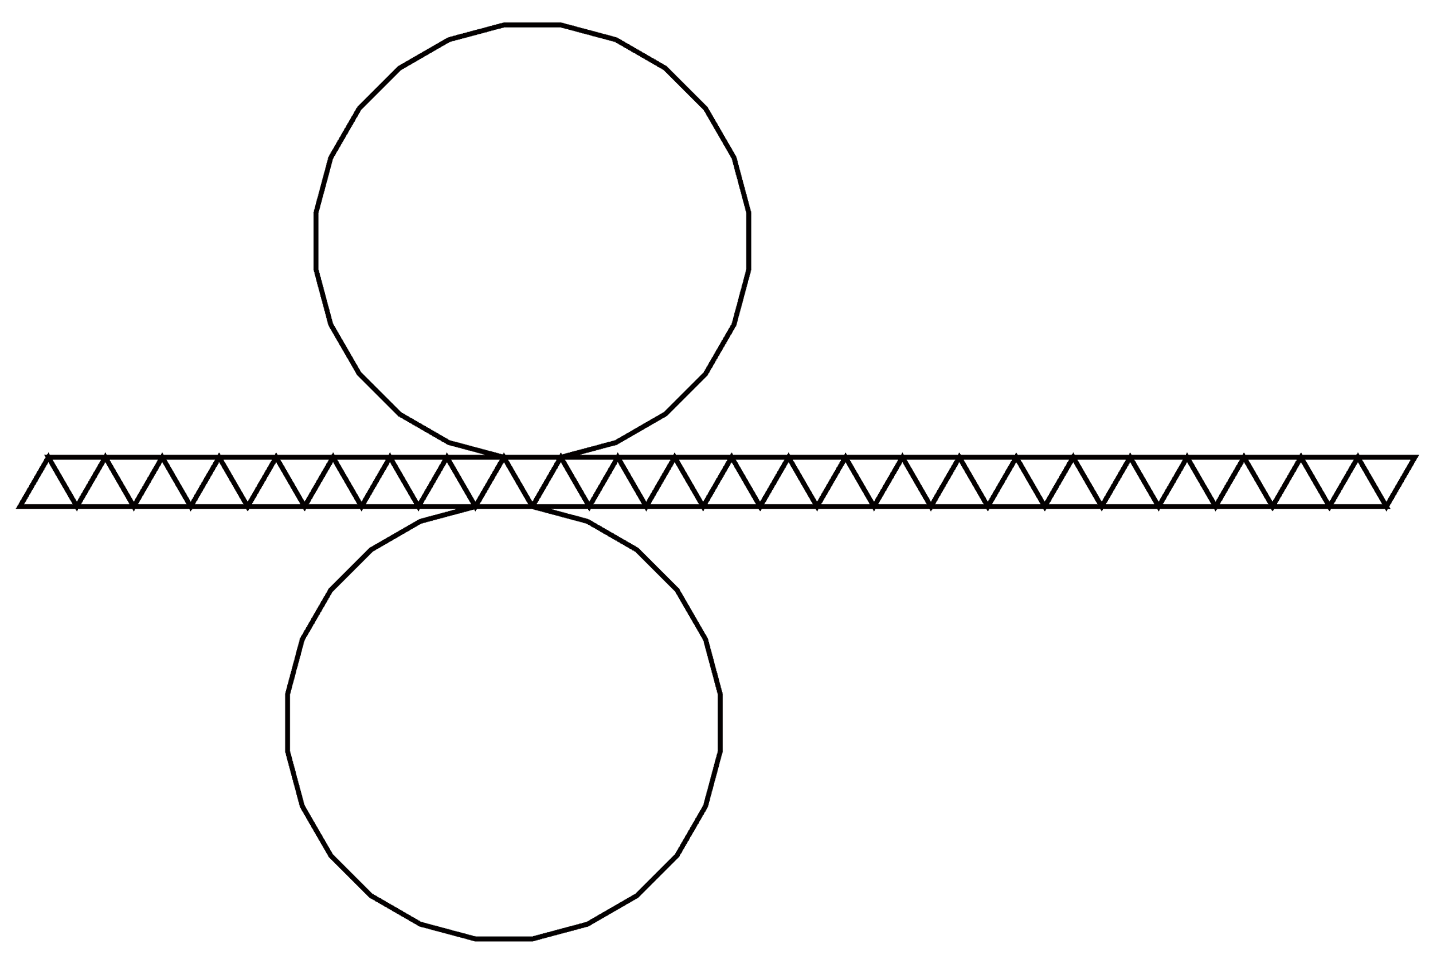
Overlapping / Non-overlapping
When the polyhedron is edge unfolded along the thick lines…
Non-overlapping
unfolding
Overlapping unfolding

Slide 6
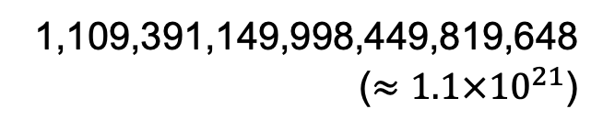
Overlapping / Non-overlapping
Cube ➡︎ No overlapping edge unfoldings
Polyhedron on the previous page
✔︎ Non-overlapping unfoldings
✔ Overlapping unfoldings
1,109,391,149,998,449,819,648
($≈1.1×{10}^{21}$)
➡︎ 162,941,846,136,285,049,392
➡︎ 946,449,303,862,164,770,256
Main results of this study
How many
are there
for each?
We proposed an approach for counting the number of non-overlapping unfoldings.

Slide 7

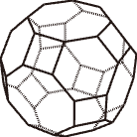
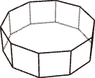
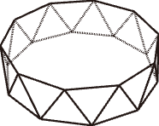
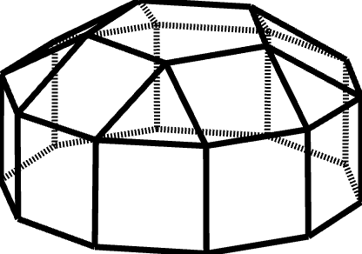
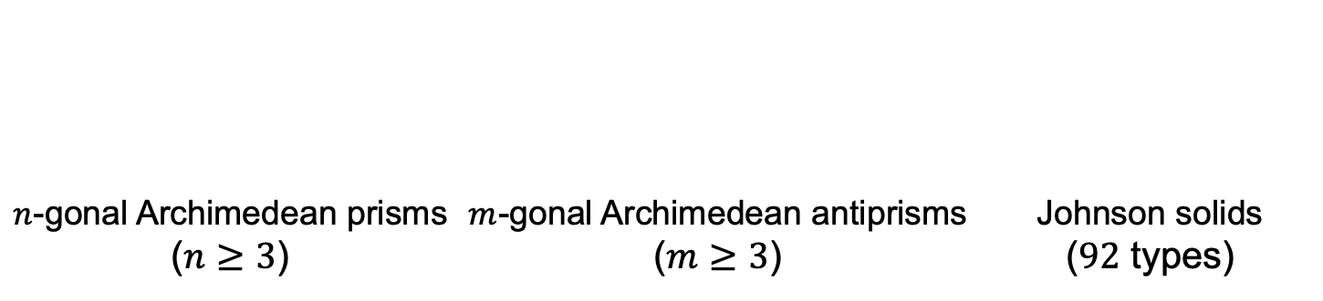
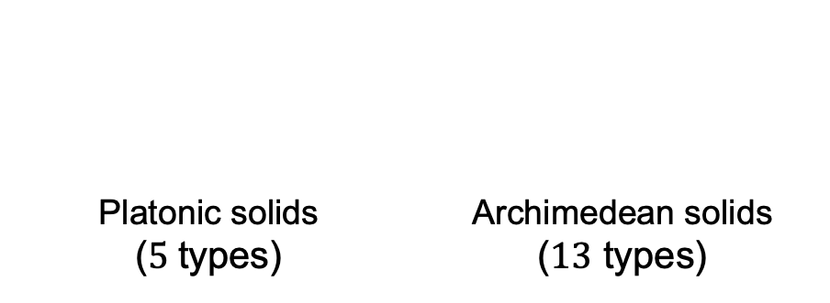
Target polyhedra
The existence of overlapping edge unfoldings is known.
[T. Horiyama and W. Shoji, 2011; T. Shiota and T. Saitoh, 2024; …]
Definition 2
If all faces of a convex polyhedron are regular polygons, it is called a convex regular-faced polyhedron.
5 classes
Platonic solids ($5$types) | Archimedean solids ($13$ types)
$n$-gonal Archimedean prisms ($n≥3$) | $m$-gonal Archimedean antiprisms ($m≥3$) | Johnson solids ($92$ types)

Slide 8
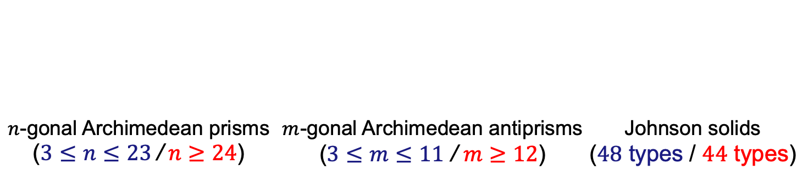
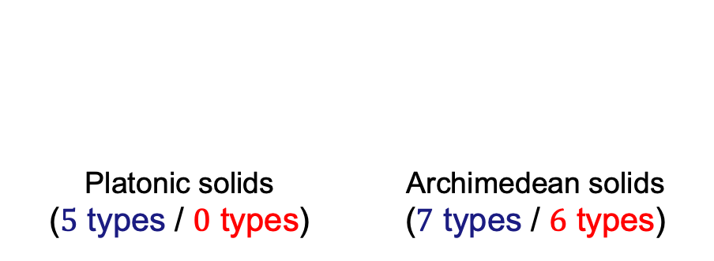
Target polyhedra
No unfolding results in overlap / Some unfolding results in overlap
The existence of overlapping edge unfoldings is known.
[T. Horiyama and W. Shoji, 2011; T. Shiota and T. Saitoh, 2024; …]
Definition 2
If all faces of a convex polyhedron are regular polygons, it is called a convex regular-faced polyhedron.
5 classes
Platonic solids ($5$ types / $0$ types) | Archimedean solids ($7$ types / $6$ types)
3 types
$n$-gonal Archimedean prisms ($3≤n≤23$ / $n≥24$) | $m$-gonal Archimedean antiprisms ($3≤m≤11$ / $m≥12$) | Johnson solids ($48$ types / $44$ types)
76 types
68 types
28 types

Slide 9
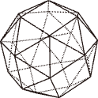
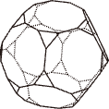
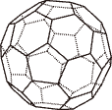
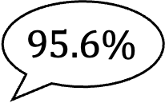
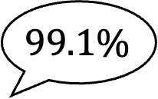
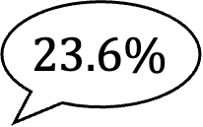
Results for Archimedean solids
Archimedean solids | #(Edge unfoldings) [T. Horiyama and W. Shoji, 2013] | #(Non-overlapping edge unfoldings)
Snub cube | 89,904,012,853,248 | 85,967,688,920,076
Truncated dodecahedron | 4,982,259,375,000,000,000 | 1,173,681,002,295,455,040
Truncated icosahedron | 375,291,866,372,898,816,000 | 371,723,160,733,469,233,260
$$95.6\%$$
$$23.6\%$$
$$99.1\%$$
Truncated
dodecahedron
Truncated
icosahedron
Sunb cube

Slide 10
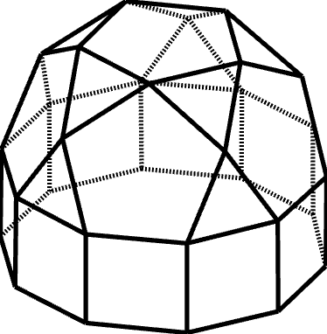
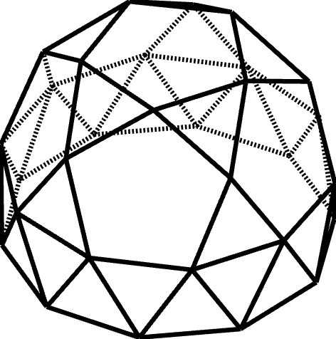
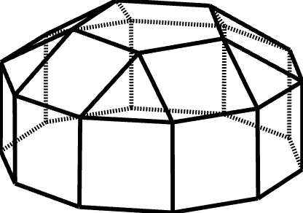
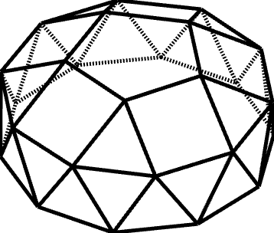
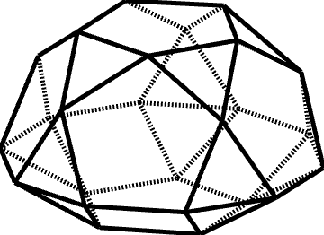
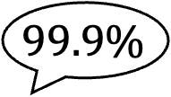
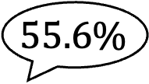
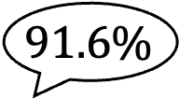

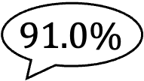
Results for Johnson solids (1)
Johnson solids | #(Edge unfoldings) [T. Horiyama and W. Shoji, 2013] | #(Non-overlapping edge unfoldings)
J20 | 29,821,320,745 | 27,158,087,415
J21 | 8,223,103,375,490 | 6,297,186,667,720
J24 | 5,996,600,870,820 | 5,492,624,228,190
J25 | 1,702,422,879,696,000 | 947,565,833,513,130
J32 | 699,537,024,120 | 699,433,603,320
$$91.0\%$$
$$76.5\%$$
$$91.6\%$$
$$55.6\%$$
$$99.9\%$$
J20
J21
J24
J25
J32

Slide 11
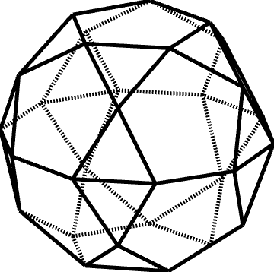
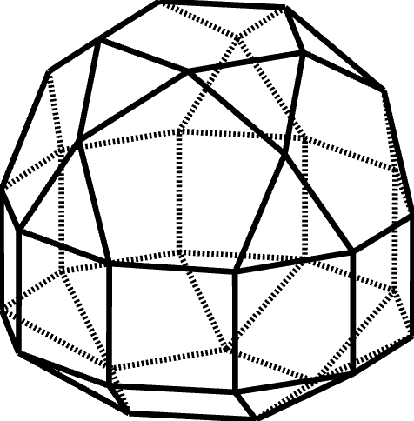
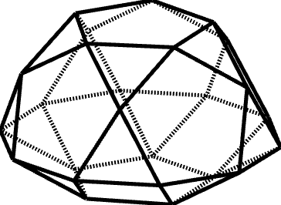
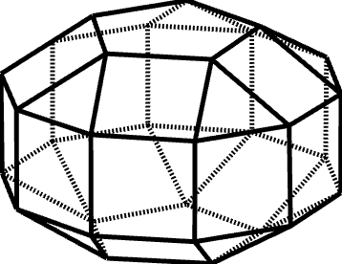
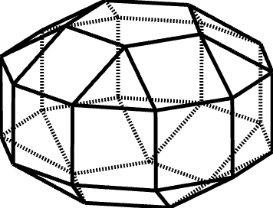
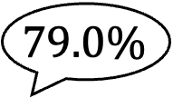
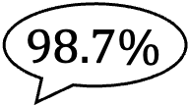
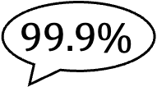
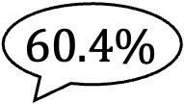
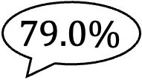
Results for Johnson solids (2)
Johnson solids | #(Edge unfoldings) [T. Horiyama and W. Shoji, 2013] | #(Non-overlapping edge unfoldings)
J33 | 745,208,449,920 | 745,105,029,120
J34 | 193,003,269,869,040 | 190,653,702,525,040
J38 | 270,745,016,304,350 | 214,085,775,357,270
J39 | 272,026,496,000,000 | 215,087,798,524,180
J40 | 75,378,202,163,880,700 | 45,541,858,035,543,690
$$98.7\%$$
$$60.4\%$$
$$99.9\%$$
$$79.0\%$$
$$79.0\%$$
J33
J34
J38
J39
J40

Slide 12
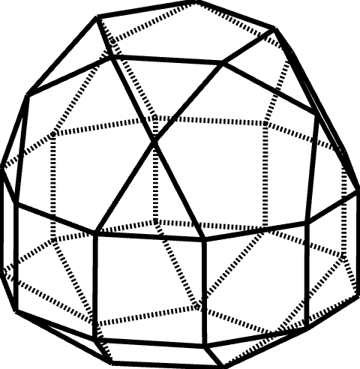
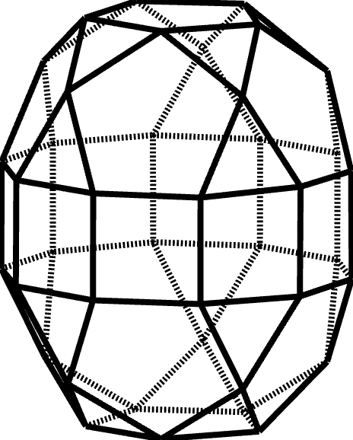
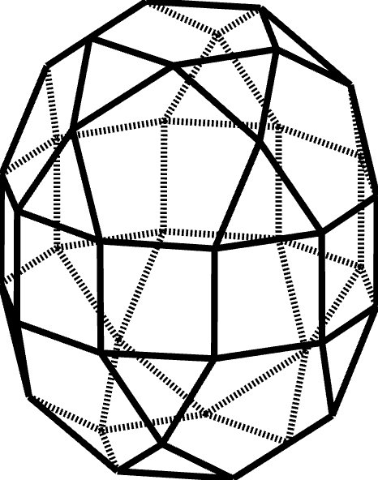
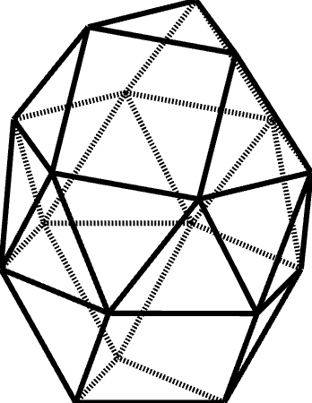
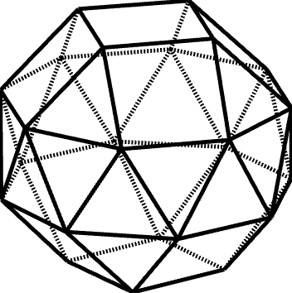
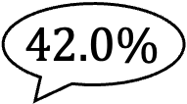
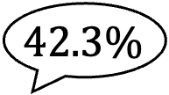
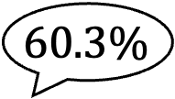
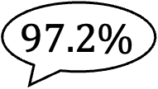
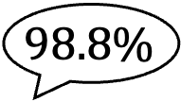
Results for Johnson solids (3)
Johnson solids | #(Edge unfoldings) [T. Horiyama and W. Shoji, 2013] | #(Non-overlapping edge unfoldings)
J41 | 75,804,411,381,317,500 | 45,774,968,967,924,850
J42 | 20,969,865,292,417,385,400 | 8,873,953,322,249,583,330
J43 | 21,115,350,368,078,435,000 | 8,884,490,741,507,534,860
J44 | 5,295,528,588 | 5,231,781,954
J45 | 13,769,880,349,680 | 13,386,219,088,644
$$60.3\%$$
$$42.3\%$$
$$42.0\%$$
$$98.8\%$$
$$97.2\%$$
J41
J42
J43
J44
J45

Slide 13
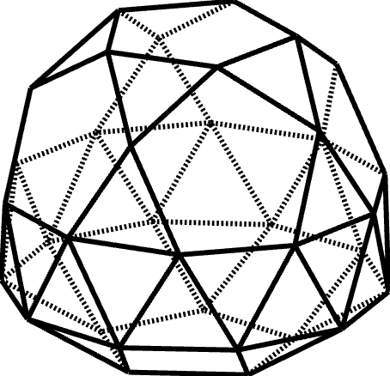
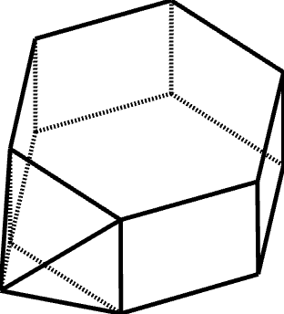
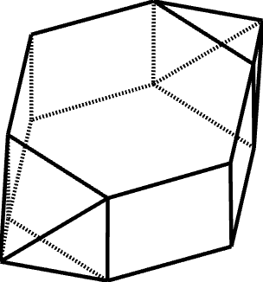
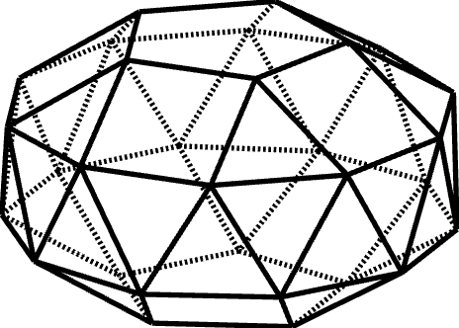

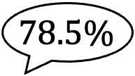


Results for Johnson solids (4)
Johnson solids | #(Edge unfoldings) [T. Horiyama and W. Shoji, 2013] | #(Non-overlapping edge unfoldings)
J46 | 32,543,644,773,848,180 | 25,553,553,814,333,235
J47 | 9,324,488,558,669,593,960 | 4,135,578,144,180,583,965
J54 | 75,973 | 75,749
J55 | 709,632 | 705,144
$$44.3\%$$
$$99.7\%$$
$$99.3\%$$
$$78.5\%$$
J46
J47
J54
J55

Slide 14










Results for Johnson solids (5)
Johnson solids | #(Edge unfoldings) [T. Horiyama and W. Shoji, 2013] | #(Non-overlapping edge unfoldings)
J56 | 707,232 | 702,520
J57 | 6,531,840 | 6,457,860
J58 | 92,724,962 | 92,219,782
J59 | 1,651,482,010 | 1,632,941,030
J60 | 1,641,317,568 | 1,621,738,522
$$99.3\%$$
$$98.8\%$$
$$99.4\%$$
$$98.8\%$$
$$98.8\%$$
J56
J57
J58
J59
J60

Slide 15








Results for Johnson solids (6)
Johnson solids | #(Edge unfoldings) [T. Horiyama and W. Shoji, 2013] | #(Non-overlapping edge unfoldings)
J61 | 28,745,798,400 | 28,183,512,978
J66 | 54,921,311,280 | 39,055,563,000
J67 | 90,974,647,120,896 | 43,437,626,181,464
J83 | 197,148,908,795,401,104 | 143,844,293,105,396,598
$$71.1\%$$
$$47.7\%$$
$$72.9\%$$
$$98.0\%$$
J61
J66
J67
J83

Slide 16

Results for Archimedean prisms (1)
Prisms | #(Edge unfoldings) [T. Horiyama and W. Shoji, 2013] | #(Non-overlapping edge unfoldings)
$24$prism | 639,620,518,118,400 | 611,750,144,604,960
$25$prism | 2,486,558,615,814,025 | 2,378,211,063,753,525
$26$prism | 9,651,161,613,824,796 | 9,120,749,762,911,540
$27$prism | 37,403,957,244,654,675 | 35,348,297,730,550,335
$28$prism | 144,763,597,316,784,768 | 136,369,030,045,792,768
$29$prism | 559,560,282,425,278,229 | 377,763,966,359,384,333
$30$prism | 2,160,318,004,043,512,500 | 1,457,228,998,699,944,660
$31$prism | 8,331,163,769,982,715,231 | 5,619,734,416,791,278,823
$32$prism | 32,095,304,749,163,937,792 | 21,649,687,090,073,296,384
$33$prism | 123,524,473,883,545,449,825 | 83,322,661,319,000,341,161
$34$prism | 474,969,297,739,230,927,564 | 320,315,730,957,505,974,740
$35$prism | 1,824,745,126,233,358,110,635 | 1,224,788,877,353,311,603,655
$36$prism | 7,004,614,136,879,907,849,600 | 4,397,626,384,555,854,813,048
$37$prism | 26,867,730,730,869,118,775,917 | 16,841,247,868,506,593,664,113
$38$prism | 102,981,783,095,242,242,871,908 | 64,245,596,838,412,691,619,868
$39$prism | 394,447,279,575,099,709,694,775 | 245,972,761,433,859,004,882,155
$40$prism | 1,509,843,372,596,510,348,221,440 | 898,435,929,860,914,751,335,120
$41$prism | 5,775,682,482,451,356,835,464,761 | 3,436,774,701,162,733,316,551,373
$42$prism | 22,080,875,606,379,223,850,418,300 | 13,138,720,470,258,404,605,154,004

Slide 17

Results for Archimedean prisms (2)
Prisms | #(Edge unfoldings) [T. Horiyama and W. Shoji, 2013] | #(Non-overlapping edge unfoldings)
$43$prism | 84,369,019,868,106,350,841,057,283 | 49,292,119,107,345,418,821,464,335
$44$prism | 322,192,014,517,039,121,756,425,344 | 188,238,848,570,683,472,535,311,712
$45$prism | 1,229,765,080,878,981,092,880,253,125 | 718,483,241,070,056,103,676,962,705
$46$prism | 4,691,535,669,063,616,134,304,408,596 | 2,731,490,668,982,448,941,464,299,772
$47$prism | 17,889,680,992,955,476,025,801,057,807 | 10,224,003,439,425,442,252,695,897,017
$48$prism | 68,185,734,533,013,527,410,214,707,200 | 38,248,653,878,322,746,431,035,217,728
$49$prism | 259,774,138,662,539,598,798,853,632,529 | 142,720,047,356,681,793,679,714,971,049
$50$prism | 989,275,799,980,653,489,079,068,384,300 | 543,491,856,931,615,421,592,902,162,300
$51$prism | 3,765,868,099,190,667,877,509,098,288,475 | 2,068,859,848,320,328,618,349,489,286,879
$52$prism | 14,329,987,768,640,883,479,630,169,743,232 | 7,785,152,064,553,875,176,792,718,269,152
$53$prism | 54,508,708,624,877,734,355,711,282,194,973 | 29,613,250,778,119,135,586,129,657,023,707
$54$prism | 207,267,558,157,030,661,743,340,920,104,900 | 112,603,308,544,085,153,945,426,983,878,660
$55$prism | 787,857,744,058,382,475,503,456,540,986,855 | 425,875,823,447,530,794,507,732,415,080,195
$56$prism | 2,993,785,586,870,888,884,013,575,853,822,976 | 1,618,161,634,602,851,785,742,807,896,140,064
$57$prism | 11,372,477,058,547,594,072,637,405,171,464,425 | 6,144,514,101,474,823,054,337,696,869,965,123
$58$prism | 43,187,270,299,014,781,811,139,187,410,691,548 | 23,326,536,057,764,626,358,265,044,412,279,868
$59$prism | 163,956,002,289,170,289,778,245,356,488,769,459 | 88,555,357,584,032,953,873,552,819,154,790,741
$60$prism | 622,263,183,812,606,109,322,543,144,035,600,000 | 336,093,972,645,843,991,118,728,788,427,726,200
$61$prism | 2,361,023,114,629,354,318,988,404,829,601,017,461 | 1,153,365,956,554,130,834,065,584,588,770,576,537

Slide 18

Results for Archimedean prisms (3)
Prisms | #(Edge unfoldings) [T. Horiyama and W. Shoji, 2013] | #(Non-overlapping edge unfoldings)
$62$prism | 8,955,908,356,422,272,120,516,285,708,666,803,572 | 4,348,799,175,168,145,604,642,783,894,710,257,972
$63$prism | 33,963,000,256,261,477,807,141,098,532,312,144,575 | 16,471,862,499,365,318,605,626,349,567,981,855,893
$64$prism | 128,763,573,367,713,152,730,420,340,995,267,231,744 | 61,639,673,042,788,410,952,524,482,230,015,782,656
$65$prism | 488,060,826,065,747,443,959,964,835,220,252,662,465 | 233,636,801,403,179,720,910,996,973,994,228,508,855
$66$prism | 1,849,490,381,600,812,352,868,765,046,397,041,481,100 | 817,502,763,787,586,935,738,546,005,495,007,277,736
$67$prism | 7,006,973,770,308,488,575,706,974,966,641,609,633,547 | 3,096,713,246,303,000,494,444,990,880,370,568,593,743
$68$prism | 26,540,686,328,811,552,652,967,327,238,752,884,476,288 | 11,708,731,916,039,177,215,090,282,288,662,448,445,864
$69$prism | 100,507,824,991,680,378,240,003,224,046,430,181,592,525 | 44,338,599,512,338,312,952,849,566,215,445,778,264,511
$70$prism | 380,536,545,795,702,174,419,400,936,760,625,367,754,020 | 167,871,805,778,112,195,880,603,660,146,778,531,028,040
$71$prism | 1,440,470,033,375,554,519,683,181,104,192,641,139,543,191 | 596,980,870,760,277,516,010,511,111,996,499,418,929,177
$72$prism | 5,451,624,356,286,428,491,183,290,436,982,561,065,036,800 | 2,259,342,205,174,960,128,925,954,191,858,205,229,812,848
$73$prism | 20,628,318,790,905,383,592,284,267,890,431,520,768,956,313 | 8,469,990,610,622,325,272,650,976,154,778,586,597,435,431
$74$prism | 78,040,535,635,296,089,880,020,963,154,546,570,729,579,324 | 32,025,918,206,891,338,090,282,229,066,878,434,112,166,032
$75$prism | 295,187,071,662,987,687,788,834,025,600,273,039,376,171,875 | 121,137,505,659,975,371,817,128,867,759,297,593,082,123,025
$76$prism | 1,116,341,857,839,528,524,717,385,720,706,815,646,963,560,576 | 458,116,563,229,230,551,652,298,491,316,191,672,953,377,976
$77$prism | 4,221,063,539,073,913,152,987,956,742,195,551,512,005,068,837 | 1,732,009,405,771,917,690,525,457,067,579,534,620,683,321,047
$78$prism | 15,957,810,909,148,397,191,421,362,206,489,368,194,976,255,700 | 6,547,759,140,478,958,708,285,931,868,337,379,111,699,013,260
$79$prism | 60,318,891,360,909,981,287,537,928,032,449,270,480,051,118,959 | 23,966,231,512,837,756,482,429,326,605,666,856,951,504,314,983
$80$prism | 227,962,700,977,360,477,553,905,172,759,643,132,779,913,338,880 | 90,516,297,016,221,842,120,588,697,662,660,340,385,338,212,160

Slide 19

Results for Archimedean prisms (4)
Prisms | #(Edge unfoldings) [T. Horiyama and W. Shoji, 2013] | #(Non-overlapping edge unfoldings)
$81$prism | 861,402,987,056,617,421,633,941,618,402,777,587,646,191,546,225 | 341,995,341,132,294,891,175,058,139,558,428,542,441,464,210,039
$82$prism | 3,254,488,598,838,582,230,210,121,899,601,749,106,776,524,965,612 | 1,292,101,188,372,407,798,075,371,911,903,984,534,028,933,754,436
$83$prism | 12,294,037,740,147,518,091,413,729,519,608,692,068,340,007,484,603 | 4,880,994,415,535,251,356,999,865,904,928,194,228,585,240,087,219
$84$prism | 46,434,768,337,561,243,483,045,269,738,500,630,193,132,229,526,400 | 18,435,535,468,052,500,560,475,959,629,177,515,836,675,305,835,264
$85$prism | 175,359,973,181,486,662,638,962,060,133,459,799,581,503,709,666,685 | 68,136,242,011,705,283,282,291,593,247,449,255,410,135,074,971,535
$86$prism | 662,151,768,698,132,480,917,981,340,031,934,840,615,593,080,769,156 | 257,261,176,564,360,166,567,970,609,875,291,471,141,053,287,325,288
$87$prism | 2,499,918,741,278,642,349,615,482,066,241,598,681,934,395,700,879,175 | 890,564,328,098,014,416,825,940,792,706,208,682,651,794,408,576,921
$88$prism | 9,437,063,110,777,086,198,028,843,620,687,140,090,853,387,600,995,328 | 3,361,807,045,468,520,205,795,018,776,129,264,881,669,261,524,635,520
$89$prism | 35,619,821,719,604,700,475,856,960,433,270,363,377,351,219,128,623,689 | 12,147,147,750,557,166,009,277,266,446,164,341,729,697,940,171,357,263
$90$prism | 134,428,635,924,381,058,558,342,373,483,695,239,998,308,348,737,337,500 | 45,835,667,167,756,167,327,808,684,200,497,934,083,305,406,003,263,080
$91$prism | 507,268,882,587,101,907,135,928,966,969,950,901,239,037,550,690,556,691 | 172,961,693,284,074,318,802,898,801,630,921,272,808,376,171,618,605,053
$92$prism | 1,913,957,124,704,016,720,646,095,852,898,568,656,870,706,493,680,372,352 | 652,587,801,648,072,657,385,242,064,252,120,087,145,845,127,550,204,344
$93$prism | 7,220,626,376,739,743,204,712,927,445,165,724,589,272,091,607,783,034,325 | 2,440,735,263,004,787,039,318,901,058,435,443,959,679,578,395,810,067,499
$94$prism | 27,237,505,194,018,078,864,602,783,571,427,472,860,418,008,032,804,687,924 | 9,200,983,829,108,871,720,824,454,037,812,685,220,751,863,003,740,596,660
$95$prism | 102,733,154,885,874,285,090,022,412,414,655,338,630,173,029,721,095,307,295 | 34,703,835,672,760,725,659,254,115,573,775,525,383,657,603,505,506,462,795
$96$prism | 387,441,199,483,882,790,074,386,518,739,975,425,611,166,119,546,861,977,600 | 130,879,809,160,332,709,730,909,060,139,747,285,756,827,067,222,934,653,120
$97$prism | 1,461,012,223,100,730,076,686,798,067,582,261,367,840,286,394,049,834,758,177 | 493,533,958,003,824,346,986,768,858,213,124,355,417,772,366,581,533,141,923
$98$prism | 5,508,783,927,988,926,594,011,003,719,084,348,517,902,267,230,291,120,238,668 | 1,842,484,668,472,842,688,235,271,932,872,735,062,103,648,776,666,005,382,528
$99$prism | 20,768,847,849,083,459,407,230,734,273,699,231,588,352,138,676,085,736,775,275 | 6,946,403,315,106,848,273,582,090,103,916,680,058,367,861,,235,272,392,879,353

Slide 20








Results for Archimedean prisms
$$94.2\%$$
$$67.5\%$$
Percentage of non-overlapping
edge unfoldings
$$33.4\%$$
$$28$$
$$29$$
$$99$$
$n$-gonal Archimedean prisms

Slide 21

Results for Archimedean antiprisms (1)
Antiprisms | #(Edge unfoldings) [T. Horiyama and W. Shoji, 2013] | #(Non-overlapping edge unfoldings)
$12$antiprism | 51,599,794,176 | 49,743,531,024
$13$antiprism | 383,142,771,674 | 369,359,503,344
$14$antiprism | 2,828,107,288,188 | 2,726,368,290,352
$15$antiprism | 20,768,716,848,000 | 20,021,578,135,380
$16$antiprism | 151,840,963,183,392 | 146,378,600,602,880
$17$antiprism | 1,105,779,284,582,146 | 989,008,190,008,480
$18$antiprism | 8,024,954,790,380,544 | 1,517,682,139,108,200
$19$antiprism | 58,059,628,319,357,318 | 10,550,126,657,845,736
$20$antiprism | 418,891,171,182,561,000 | 72,542,787,706,846,320
$21$antiprism | 3,014,678,940,049,375,872 | 500,034,989,831,068,818
$22$antiprism | 21,646,865,272,061,272,716 | 3,449,844,625,120,946,448
$23$antiprism | 155,113,904,634,576,144,814 | 23,752,014,262,731,255,118
$24$antiprism | 1,109,391,149,998,449,819,648 | 162,941,846,136,285,049,392
$25$antiprism | 7,920,708,398,483,722,531,250 | 1,117,782,108,867,439,830,950
$26$antiprism | 56,460,916,728,463,179,389,652 | 7,655,723,643,342,875,568,936
$27$antiprism | 401,873,068,071,158,383,691,136 | 40,561,091,359,603,932,081,708
$28$antiprism | 2,856,496,726,273,368,888,420,984 | 264,478,642,931,290,919,674,648

Slide 22

Results for Archimedean antiprisms (2)
Antiprisms | #(Edge unfoldings) [T. Horiyama and W. Shoji, 2013] | #(Non-overlapping edge unfoldings)
$29$antiprism | 20,277,959,821,998,087,658,569,178 | 1,739,241,575,214,473,110,359,470
$30$antiprism | 143,779,866,504,299,168,102,784,000 | 11,718,403,001,480,040,992,138,460
$31$antiprism | 1,018,331,261,238,041,888,906,149,982 | 79,227,778,390,260,949,681,648,022
$32$antiprism | 7,204,899,406,395,028,729,775,662,656 | 535,088,808,567,353,165,252,109,504
$33$antiprism | 50,926,337,537,628,456,148,426,034,304 | 3,609,765,503,967,786,066,361,340,190
$34$antiprism | 359,631,713,591,480,208,135,988,999,908 | 23,021,698,690,971,475,731,990,378,832
$35$antiprism | 2,537,451,036,289,964,010,662,071,375,750 | 155,062,662,340,102,785,066,461,404,560
$36$antiprism | 17,888,860,941,014,408,891,681,749,082,112 | 1,043,552,488,055,809,272,918,087,425,832
$37$antiprism | 126,017,967,976,156,654,397,534,266,950,026 | 6,992,936,456,851,489,392,078,163,320,978
$38$antiprism | 887,084,326,468,926,324,030,843,544,372,524 | 44,438,923,337,128,563,356,651,187,920,012
$39$antiprism | 6,240,170,805,918,890,922,630,444,422,537,088 | 297,478,382,005,821,691,364,579,412,449,706
$40$antiprism | 43,867,453,323,674,409,143,926,999,140,738,000 | 1,983,085,398,586,205,226,911,001,715,311,520
$41$antiprism | 308,188,798,032,167,102,842,859,597,775,205,042 | 13,033,685,199,501,916,122,251,960,215,169,912
$42$antiprism | 2,163,878,359,899,340,120,052,552,791,046,378,496 | 83,997,191,224,353,764,482,646,914,913,598,624
$43$antiprism | 15,184,572,514,675,762,272,842,247,131,661,635,894 | 557,611,275,066,805,327,907,702,044,873,987,094
$44$antiprism | 106,496,994,569,720,990,727,767,374,869,609,730,968 | 3,729,635,546,799,294,784,771,659,621,890,472,664
$45$antiprism | 746,530,833,968,188,588,851,681,523,936,666,896,000 | 24,431,729,185,673,950,396,752,450,635,669,388,990

Slide 23

Results for Archimedean antiprisms (3)
Antiprisms | #(Edge unfoldings) [T. Horiyama and W. Shoji, 2013] | #(Non-overlapping edge unfoldings)
$46$antiprism | 5,230,505,089,344,431,048,507,144,123,815,456,787,772 | 158,880,058,222,038,902,280,026,924,999,326,487,380
$47$antiprism | 36,629,772,069,905,834,755,580,161,013,689,257,929,566 | 1,060,539,783,181,405,072,337,781,040,938,759,619,342
$48$antiprism | 256,405,984,103,100,622,357,453,677,837,305,041,649,664 | 7,079,805,121,439,383,694,342,635,647,608,115,253,632
$49$antiprism | 1,794,045,942,295,064,986,560,011,614,233,598,156,819,298 | 47,081,894,856,079,882,568,065,465,270,204,379,835,426
$50$antiprism | 12,547,524,306,762,115,327,139,640,139,635,651,225,562,500 | 313,979,052,982,335,359,074,797,901,078,961,675,923,700
$51$antiprism | 87,722,051,242,994,803,143,643,140,957,694,192,485,255,552 | 2,093,220,753,862,771,345,181,080,442,901,094,417,625,334
$52$antiprism | 613,045,214,965,087,171,516,365,035,207,733,551,443,709,736 | 13,847,372,368,702,386,134,230,159,841,426,631,160,249,520
$53$antiprism | 4,282,679,690,470,859,990,496,705,254,406,531,422,464,957,834 | 92,254,873,128,059,280,848,212,456,691,530,042,110,511,660
$54$antiprism | 29,907,770,896,467,759,248,303,121,099,365,111,834,448,227,328 | 612,564,147,448,713,555,111,946,603,958,121,691,610,818,284
$55$antiprism | 208,787,039,294,802,995,558,997,194,768,329,038,664,289,012,750 | 4,066,189,399,259,848,921,000,213,749,369,244,891,377,708,200
$56$antiprism | 1,457,066,704,859,013,168,857,939,059,215,469,544,106,252,283,632 | 26,882,734,603,660,531,639,929,002,113,295,431,420,663,838,960
$57$antiprism | 10,165,220,976,851,309,359,988,036,885,968,497,679,868,602,544,256 | 177,996,738,793,784,313,663,675,391,748,841,946,567,960,370,322
$58$antiprism | 70,895,802,507,339,433,606,655,281,989,227,262,198,207,167,104,404 | 1,180,051,219,817,443,505,617,832,090,129,322,320,242,838,961,804
$59$antiprism | 494,305,112,112,066,674,502,236,216,299,036,533,680,424,852,661,558 | 7,834,254,664,590,050,866,382,827,703,061,557,850,624,078,276,054
$60$antiprism | 3,445,441,668,665,681,646,962,862,224,080,264,597,391,436,598,272,000 | 50,403,377,478,963,170,902,563,467,427,787,499,348,682,069,083,400
$61$antiprism | 24,008,998,657,730,043,418,999,210,016,836,054,318,873,476,626,984,762 | 326,358,125,570,791,131,913,614,291,766,990,868,139,803,779,993,658
$62$antiprism | 167,257,831,873,332,437,880,307,618,553,808,550,206,593,147,036,070,876 | 1,854,939,808,105,063,172,332,156,437,560,469,843,454,970,270,135,872

Slide 24

Results for Archimedean antiprisms (4)
Antiprisms | #(Edge unfoldings) [T. Horiyama and W. Shoji, 2013] | #(Non-overlapping edge unfoldings)
$63$antiprism | 1,164,892,592,931,629,392,338,324,783,815,505,600,459,556,438,051,914,624 | 12,307,784,791,893,071,962,543,568,932,644,431,739,514,519,035,956,010
$64$antiprism | 8,111,027,415,042,412,087,059,884,505,184,466,841,764,376,870,066,703,488 | 81,711,622,221,644,705,528,593,850,868,389,602,010,305,415,118,773,632
$65$antiprism | 56,462,462,218,649,594,296,489,126,547,728,233,809,837,328,422,164,209,250 | 542,324,566,561,175,718,389,472,139,379,279,869,381,405,090,020,827,940
$66$antiprism | 392,953,311,363,100,782,765,649,901,258,650,734,263,966,574,522,587,784,192 | 3,596,222,163,944,667,874,762,237,572,824,582,243,007,524,492,920,016,364
$67$antiprism | 2,734,150,277,149,943,789,424,653,221,975,737,385,578,070,013,528,736,239,846 | 23,843,879,380,617,148,795,466,186,545,241,390,034,312,194,471,190,721,410
$68$antiprism | 19,019,848,444,227,125,038,960,788,030,632,146,757,126,643,109,790,562,588,744 | 158,047,277,673,032,158,023,557,741,664,008,526,923,236,605,161,466,417,144
$69$antiprism | 132,281,097,981,397,378,649,216,327,599,160,829,981,177,127,561,996,392,778,368 | 1,047,172,473,392,558,836,251,756,065,865,616,682,360,236,358,525,772,236,994
$70$antiprism | 919,808,251,652,716,036,371,207,892,032,413,807,786,850,000,883,510,526,443,500 | 6,,940,458,038,739,497,932,445,601,709,547,911,589,835,564,772,106,776,166,220
$71$antiprism | 6,394,523,254,028,788,004,842,904,160,103,465,297,190,061,440,230,870,478,513,422 | 45,780,684,032,708,802,155,441,190,837,474,021,683,024,682,589,684,818,605,684
$72$antiprism | 44,446,020,245,409,850,388,919,123,546,153,029,436,510,863,260,931,308,786,876,416 | 303,133,167,415,275,991,480,997,730,729,891,095,322,066,594,918,858,437,619,312
$73$antiprism | 308,868,631,905,426,344,328,427,311,641,720,314,433,493,675,086,071,079,589,514,514 | 1,993,862,494,867,116,801,892,228,563,979,771,114,995,027,333,450,860,247,871,268
$74$antiprism | 2,146,017,331,464,816,766,794,536,512,479,696,001,159,731,435,059,847,042,295,248,948 | 13,209,556,361,833,768,036,797,427,669,629,105,268,373,114,777,374,196,971,004,696
$75$antiprism | 14,907,792,173,512,400,291,813,743,106,474,046,926,942,024,685,661,040,985,606,000,000 | 87,479,366,310,664,176,876,248,551,641,616,300,775,155,031,501,800,307,738,254,650
$76$antiprism | 103,541,921,350,898,507,949,080,104,593,610,092,290,674,442,999,146,438,446,892,628,952 | 575,728,071,259,409,983,216,254,627,908,333,000,969,928,942,023,795,016,355,188,312
$77$antiprism | 719,024,872,072,048,704,795,415,649,743,438,922,497,201,689,435,088,835,503,134,774,586 | 3,803,094,888,814,534,194,244,711,198,507,594,930,371,276,487,989,070,769,505,333,618
$78$antiprism | 4,992,273,293,210,566,749,051,331,629,112,187,169,112,455,673,298,970,063,008,551,517,184 | 25,178,232,163,989,764,173,902,561,452,762,553,210,080,327,618,722,145,846,907,592,560
$79$antiprism | 34,656,236,736,012,517,253,147,752,391,859,302,565,359,593,442,298,439,368,730,738,540,478 | 166,652,766,549,703,045,550,278,222,766,074,887,734,370,837,666,827,789,428,184,155,666

Slide 25










Results for Archimedean antiprisms
$$89.4\%$$
Percentage of non-overlapping
edge unfoldings
$$18.9\%$$
$$1.0\%$$
$$0.4\%$$
$$17$$
$$18$$
$$79$$
$$64$$
$m$-gonal Archimedean antiprisms

Slide 26






#(Edge unfoldings) include overlaps
Let $V$ be the set of vertices and $E$ the set of edges. Then, $Q$ can be seen as a graph $G_{Q}=(V, E)$.
$$E_{U}$$
Polyhedron$Q$
Theorem 3 [E. D. Demaine et al., 2007]
Let $E_{U}\left(⊂E\right)$ be the set of edges cut to obtain an unfolding $U$. Then, $E_{U}$ corresponds to a spanning tree in $G_{Q}$.
Edge unfolding $U$
Key point:
If we want to get the number of edge unfoldings, we can count the number of spanning trees in $G_{Q}$ instead.

Slide 27





















#(Edge unfoldings) include overlaps
#(Spanning trees in $G$) can be counted using ZDDs.
[J. Kawahara et al., 2017]
$$e_{0}$$
$$e_{1}$$
$$e_{1}$$
Zero-suppressed Decision Diagram
(ZDD) [S. Minato, 1993]
$$e_{2}$$
$$e_{2}$$
$$e_{2}$$
$$e_{2}$$
$$e_{3}$$
$$e_{3}$$
$$e_{3}$$
A data structure that compactly represents a family of sets as a directed acyclic graph (DAG).
$$e_{4}$$
$$e_{4}$$
$$e_{4}$$
$$e_{5}$$
$$0$$
$$1$$
We can use various operations over ZDDs.
♢
$$＝$$
♢$＝\{∪, ∩, ∖,…\}$
$$𝒵_{𝒜}$$
$$𝒵_{ℬ}$$
$$𝒵_{𝒩}$$

Slide 28




Operations over ZDDs
Subsetting technique [H. Iwashita and S. Minato, 2013]
Constructs a new ZDD $𝒵_{𝒩}$ by extracting a family of sets from an existing ZDD $𝒵$ that satisfies a constraint $𝒞$.
$$𝒵$$
$$𝒵_{𝒞}$$
$$𝒵_{𝒩}$$
Key point:
Using the subsetting technique, we removed overlapping edge unfoldings and counted #(non-overlapping edge unfoldings).

Slide 29













#(Non-overlapping edge unfoldings)
[Ex.] Overlapping edge unfolding $U_{1}$
[T. Shiota and T. Saitoh, 2024]
$$e_{1}$$
$$e_{0}$$
$$e_{6}$$
$$e_{2}$$
$$e_{5}$$
$$e_{3}$$
$$e_{4}$$
Minimal overlapping
partial unfolding $M_{1}$
MOPU
$NC[U]$: Set of edges that are not cut in unfolding $U$
$NC\left[U_{1}\right]=\{e_{0},e_{1},…,e_{6},e_{7},…,e_{14}\}$
$NC\left[U_{1}\right]=\{e_{0},e_{1},…,e_{6},e_{7},…,e_{14}\}$
$NC\left[M_{1}\right]=\{e_{0},e_{1},…,e_{6}\}$
$NC\left[M_{1}\right]=\{e_{0},e_{1},…,e_{6}\}$
Key point:
If $NC[M_{1}]⊆NC[U]$, the edge unfoldings always overlaps.

Slide 30

#(Non-overlapping edge unfoldings)
[Ex.] Overlapping edge unfolding $U_{1}$
[T. Shiota and T. Saitoh, 2024]
$$e_{1}$$
$$e_{0}$$
$$e_{6}$$
$$e_{2}$$
$$e_{5}$$
$$e_{3}$$
$$e_{4}$$
Minimal overlapping
partial unfolding $M_{1}$
MOPU
$NC[U]$: Set of edges that are not cut in unfolding $U$
$NC\left[U_{1}\right]=\{e_{0},e_{1},…,e_{6},e_{7}, …,x\}$
$NC\left[M_{1}\right]=\{e_{0},e_{1},…,e_{6}\}$
Key point:
If $NC[M_{1}]⊆NC[U]$, the edge unfoldings always overlaps.

Slide 31

#(Non-overlapping edge unfoldings)
[Ex.] Overlapping edge unfolding $U_{1}$
[T. Shiota and T. Saitoh, 2024]
$$e_{1}$$
$$e_{0}$$
$$e_{6}$$
$$e_{2}$$
$$e_{5}$$
$$e_{3}$$
$$e_{4}$$
Minimal overlapping
partial unfolding $M_{1}$
MOPU
$NC[U]$: Set of edges that are not cut in unfolding $U$
$NC\left[U_{1}\right]=\{e_{0},e_{1},…,e_{6},a,…,x\}$
$NC\left[M_{1}\right]=\{e_{0},e_{1},…,e_{6}\}$
Key point:
If $NC[M_{1}]⊆NC[U]$, the edge unfoldings always overlaps.

Slide 32

#(Non-overlapping edge unfoldings)
[Ex.] Overlapping edge unfolding $U_{1}$
[T. Shiota and T. Saitoh, 2024]
$$e_{1}$$
$$e_{0}$$
$$e_{6}$$
$$e_{2}$$
$$e_{5}$$
$$e_{3}$$
$$e_{4}$$
Minimal overlapping
partial unfolding $M_{1}$
MOPU
$NC[U]$: Set of edges that are not cut in unfolding $U$
$NC\left[U_{1}\right]=\{e_{0},e_{1},…,e_{6},a,…,y\}$
$NC\left[M_{1}\right]=\{e_{0},e_{1},…,e_{6}\}$
Key point:
If $NC[M_{1}]⊆NC[U]$, the edge unfoldings always overlaps.

Slide 33












#(Non-overlapping edge unfoldings)
Subsetting technique
$$e_{1}$$
[Ex.] Overlapping edge unfolding $U_{1}$
[T. Shiota and T. Saitoh, 2024]
$$e_{0}$$
$$𝒵_{ℳ_{1}}$$
$$e_{6}$$
$$𝒵_{𝒮}$$
$$e_{2}$$
$$𝒵_{\overline{ℳ_{1}}}$$
$$e_{5}$$
$$e_{3}$$
$$e_{4}$$
The family of sets that contains all elements of $NC[M_{1}]$
Minimal overlapping
partial unfolding $M_{1}$
The edge unfoldings that do not include $M_{1}$ as a partial unfolding
All edge unfoldings
MOPU
$NC[U]$: Set of edges that are not cut in unfolding $U$
$NC\left[U_{1}\right]=\{e_{0},e_{1},…,e_{6},a,…,y\}$
$NC\left[M_{1}\right]=\{e_{0},e_{1},…,e_{6}\}$
Key point:
If $NC[M_{1}]⊆NC[U]$, the edge unfoldings always overlaps.

Slide 34












#(Non-overlapping edge unfoldings)
MOPUs $M_{k}$ can be enumerated using rotational unfolding.
Truncated icosahedron
$$⋯$$
[T. Shiota and T. Saitoh, 2024]
$ℓ$: #(MOPUs) in a polyhedron $Q$
$$ℓ=240$$
Apply the subsetting technique to all MOPUs $M_{k} (1≤ k≤ℓ)$
$$𝒵_{ℳ_{1}}$$
$$⋯$$
$$𝓏_{ℳ_{k}}$$
$$𝒵_{S}$$
$$𝒵_{\overline{ℳ_{1}}∪…∪\overline{ℳ_{ℓ}}}$$
The edge unfoldings that do not include any $M_{k }$as a partial unfolding
The ZDD representing non-overlapping edge unfoldings.

Slide 35
Conclusion
Developed an algorithm to count the number of non-overlapping edge unfoldings
Applied the algorithm to the 175 types of convex regular-faced polyhedra
Platonic solids ($5$ types / $0$ types) | Archimedean solids ($7$ types / $6$ types)
3 types
$n$-gonal Archimedean prisms ($3≤n≤23$ / $n≥24$) | $m$-gonal Archimedean antiprisms ($3≤m≤11$ / $m≥12$) | Johnson solids ($48$ types / $44$ types)
76 types
68 types
28 types

Slide 36
Appendix

Slide 37
Cause of the sharp percentage drop
$$94.2\%$$
$$67.5\%$$
Percentage of non-overlapping
edge unfoldings
$$33.4\%$$
$$28$$
$$29$$
$$99$$
$n$-gonal Archimedean prisms

Slide 38




Cause of the sharp percentage drop
Types of MOPUs for Archimedean $n$-gonal prisms
$$n≥24$$
$$n≥26$$
$$n≥28$$
6
7
8
$$n≥29$$
5
5

Slide 39
Cause of the sharp percentage drop
$$89.4\%$$
Percentage of non-overlapping
edge unfoldings
$$18.9\%$$
$$1.0\%$$
$$0.4\%$$
$$17$$
$$18$$
$$79$$
$$64$$
$m$-gonal Archimedean antiprisms

Slide 40



Cause of the sharp percentage drop
Types of MOPUs for Archimedean $m$-gonal antiprisms
$$m≥12$$
$$m≥17$$
8
8
8
6
6
6
$$m≥18$$

Slide 41





Background of this study
Open problem (Dürer’s problem) [G. C. Shephard, 1975]
Can every convex polyhedron be edge-unfolded without overlaps?
Key points for solve this problem
To find a convex polyhedron that overlaps in any possible
edge unfolding.
To present an edge-unfolding algorithm that applies to all
convex polyhedra.

Slide 42


Background of this study
[C. A. Schevon, 1989]
For randomly generated convex polyhedra, the percentage of non-overlapping edge unfoldings decreases as the number of vertices increases.
Each point …
Shows the average percentage of non-overlapping edge unfoldings.
Uses data from 1,000 random unfoldings for each of five polyhedra.
Percentage of
non-overlapping
edge unfoldings
$|V|$ in polyhedra

